Slide 1
Medical Health Diagnosis
Varun Khachane (RA2011026010072)
Sahil Satasiya (RA2011026010110)
Shresth Gupta (RA2011026010091)

Slide 2

Table of contents
01
02
04
Introduction
Medical Diagnosis
03
Breast Cancer
Detection
Brain Tumor
Detection

Slide 3
01
Introduction
Introduction

Slide 4
Introduction
AI is transforming the practice of medicine. It’s helping doctors diagnose patients more accurately, make predictions about patients’ future health, and recommend better treatments.
Medicine is one of the fastest-growing and important application areas, with unique challenges like handling missing data. In this project, we’ll be working on the nuances of working with 2D and 3D medical image data. We’ll then apply tree-based models to improve patient survival estimates. We’ll also use data from randomized trials to recommend treatments more suited to individual patients. Finally, we’ll explore how natural language extraction can more efficiently label medical datasets.

Slide 5
02
Medical Diagnosis

Slide 6
Medical Diagnosis
Medical diagnosis is the process of determining which disease or condition explains a person's symptoms and signs. It is most often referred to as diagnosis with the medical context being implicit. The information required for diagnosis is typically collected from a history and physical examination of the person seeking medical care. Often, one or more diagnostic procedures, such as medical tests, are also done during the process.

Slide 7
03
Breast Cancer Detection

Slide 8
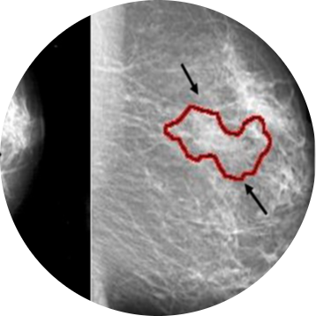
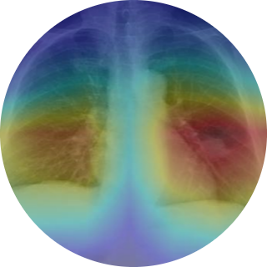
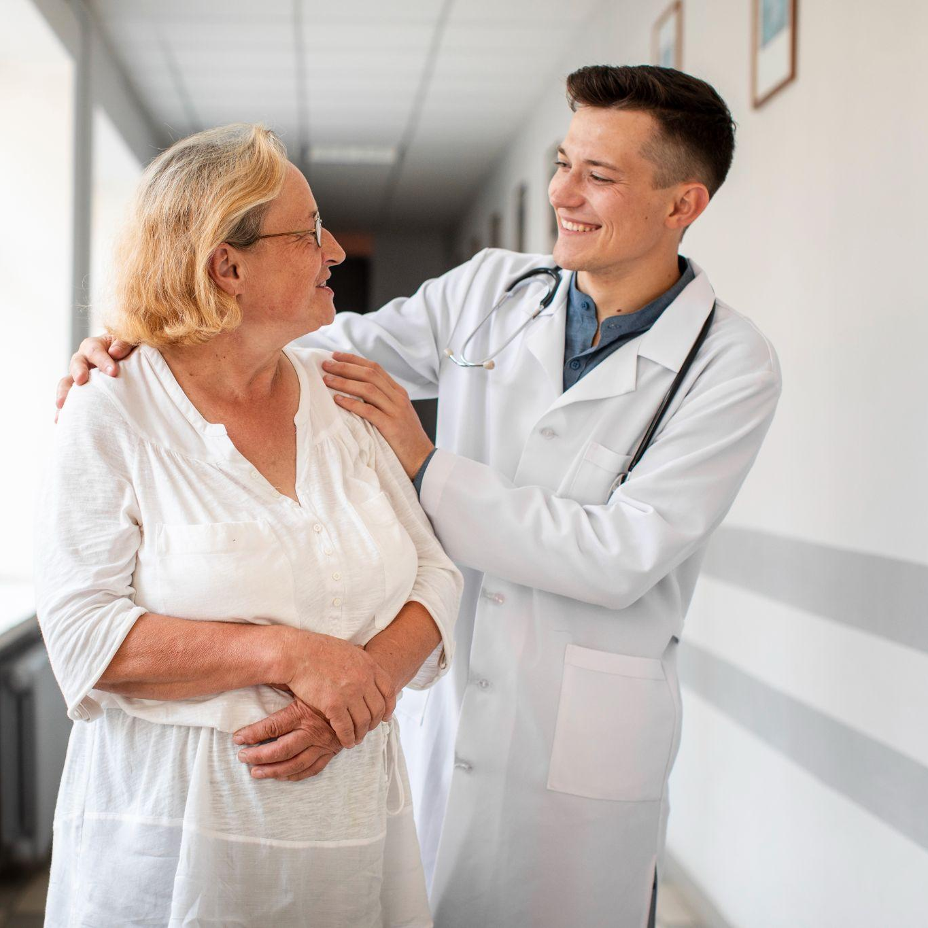
Breast Cancer Detection
Machine learning helps with early diagnosis of breast cancer and determines the nature of the cancer by analysing the tumor size. Breast cancer research could benefit from ML techniques used to identify cancer and predict the presence or absence of tumors. Machine learning techniques can also be used to predict tumour malignancy

Slide 9
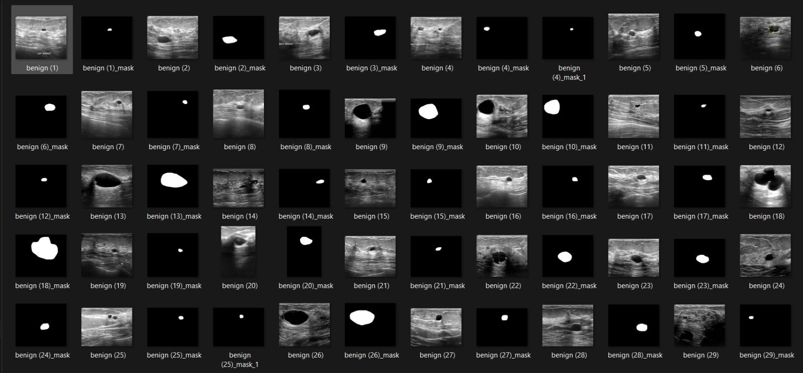
Dataset
The data collected at baseline include breast ultrasound images among women in ages between 25 and 75 years old. The number of patients is 600 female patients. The dataset consists of 780 images with an average image size of 500*500 pixels. The images are categorized into three classes, which are normal, benign, and malignant.

Slide 10
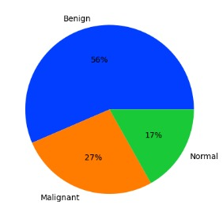
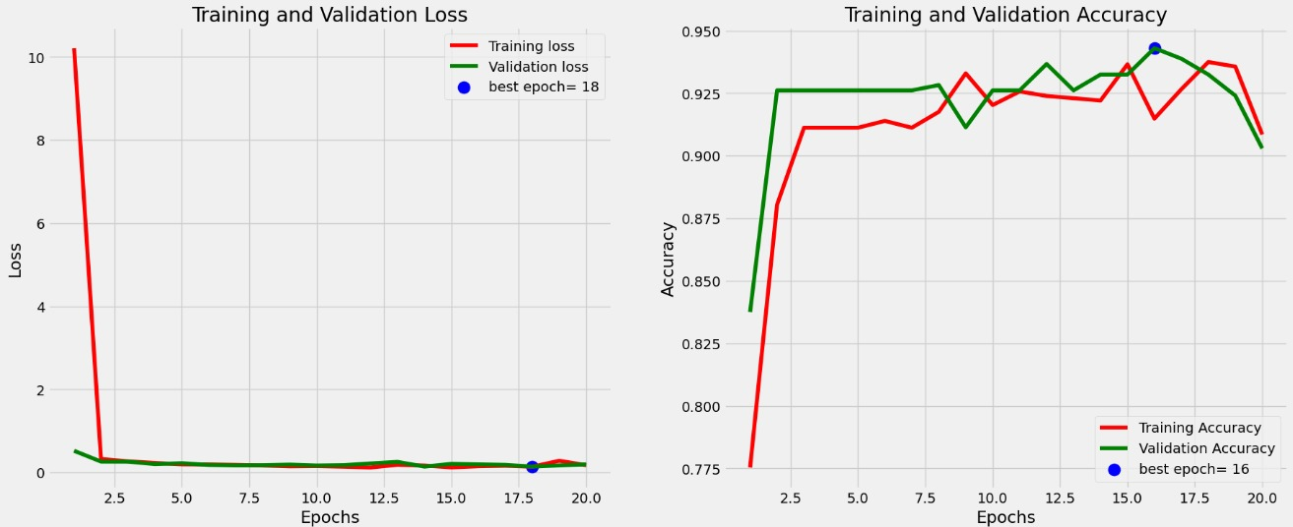
Visualization
Accuracy of the model
Ratio of different types
of breast cancer

Slide 11
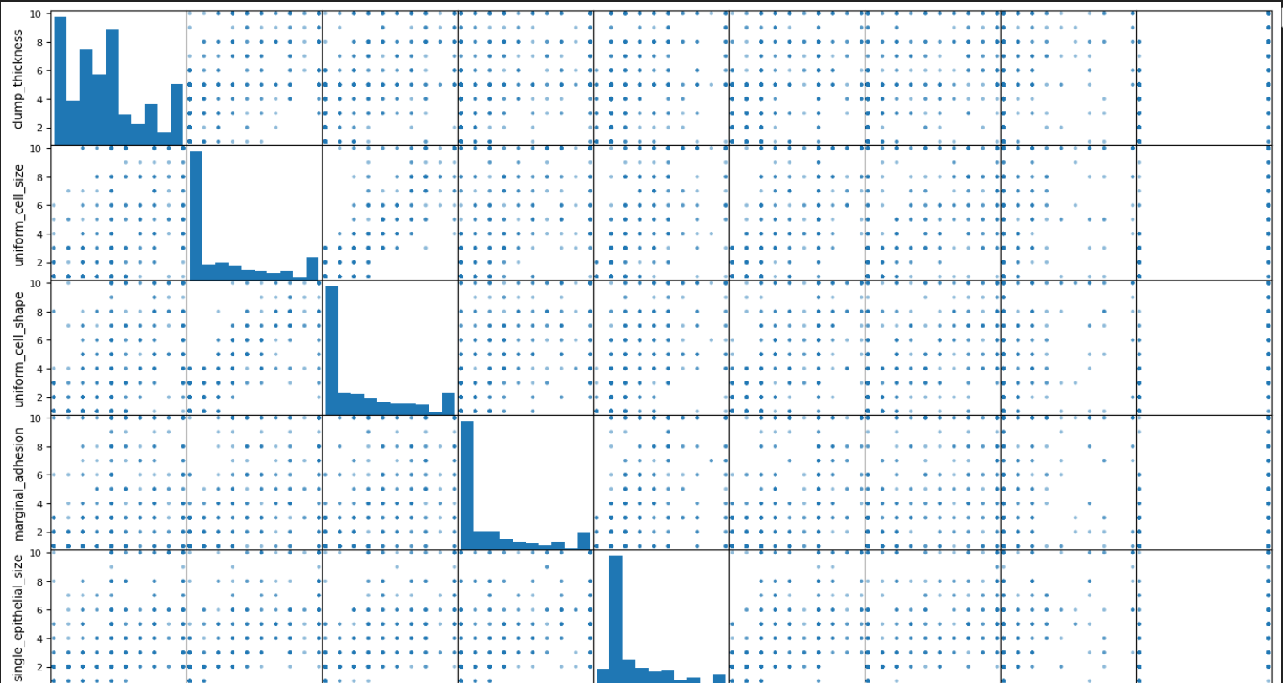
Evaluation of Diagnosis

Slide 12
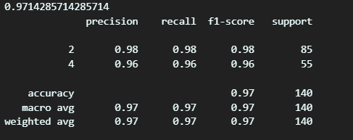
Evaluated Output
The model gives a training accuracy of 97.13% and validation accuracy 95.20% this is a high accuracy and I think it can be better if I managed to make the set more balanced the loss is quite impressive around 0.07 for training and 0.14 for validation

Slide 13
04
Brain Tumor Detection

Slide 14
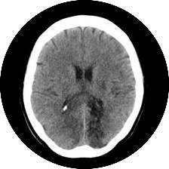
Brain Tumor Detection
The process of diagnosing brain tumors is very complicated for many reasons, including the brain’s synaptic structure, size, and shape. Machine learning techniques are employed to help doctors to detect brain tumor and support their decisions. In recent years, deep learning techniques have made a great achievement in medical image analysis.

Slide 15
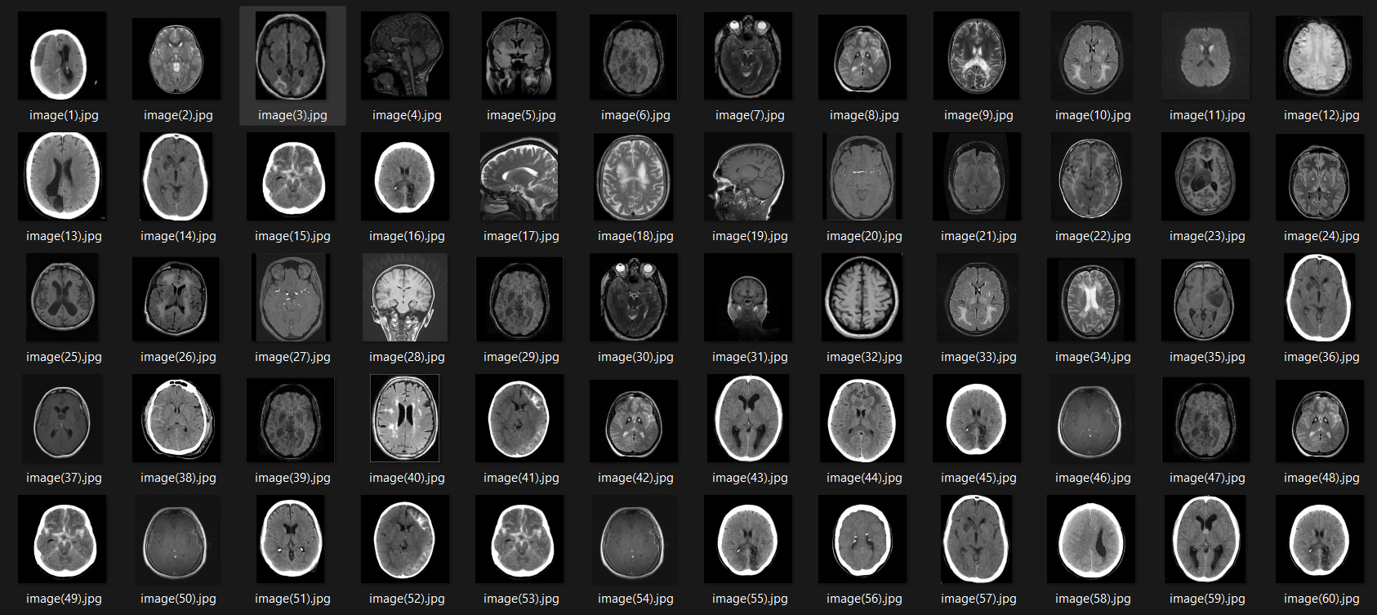
Dataset
The dataset for Brain Tumor Detection is divided into two sets – Training and Testing. The training dataset has 4 types of tumors – no tumor, glioma tumor, meningioma tumor and pituitary tumor. The model uses this training dataset to train the model and then use the testing dataset to test the model and adjust the hyperparameters to increase the accuracy.

Slide 16
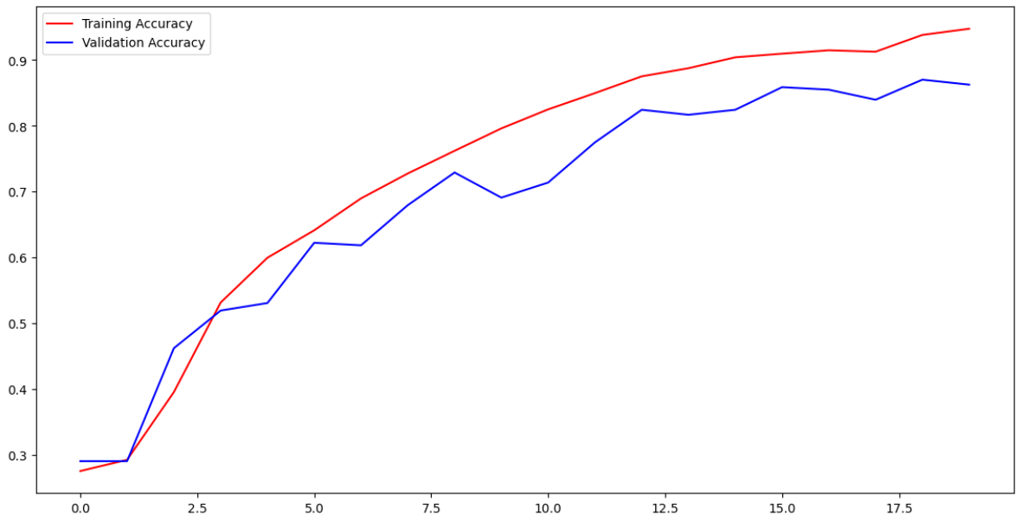
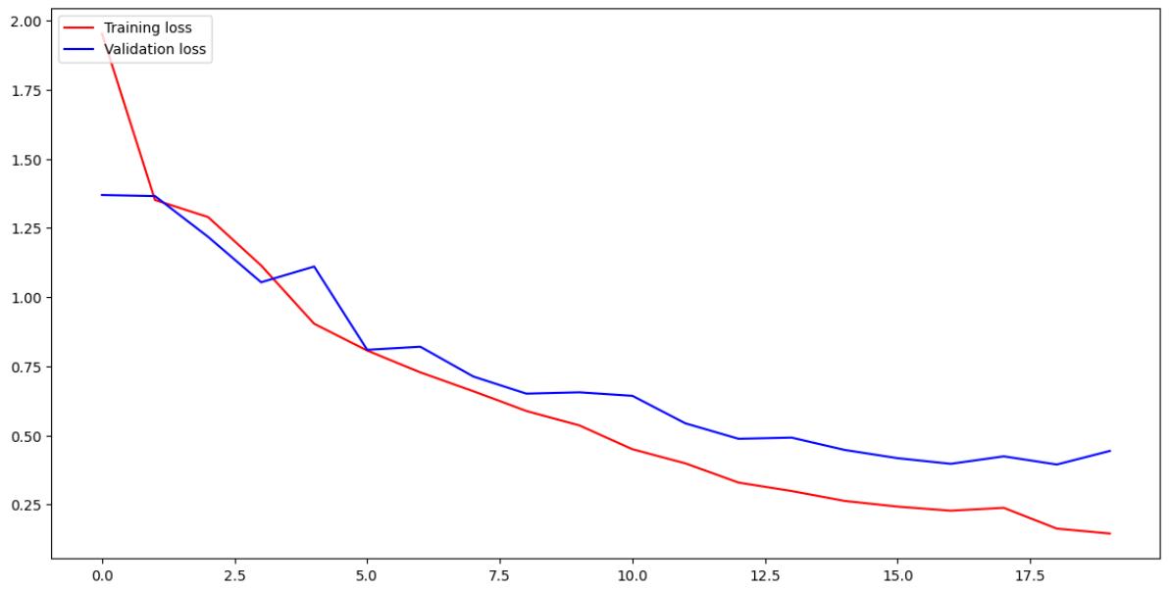
Visualization
Accuracy of the model
Loss occurred while training the model

Slide 17
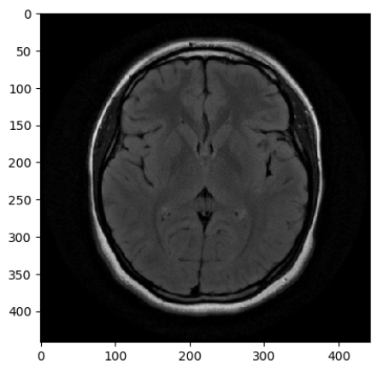

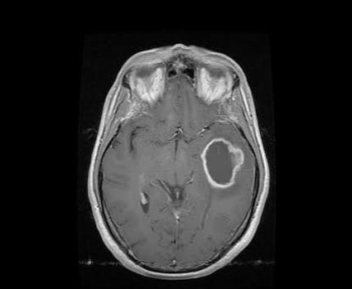
Evaluated Output
No tumor
Glioma Tumor

Slide 18
GitHub Link
Sahil Satasiya (RA2011026010110) – https://github.com/sahil1402/Medical-Health-Diagnosis
Shresth Gupta (RA2011026010091) – https://github.com/Spamster1306/Medical-Healt-Diagnosis
Varun Khachane (RA2011026010072) – https://github.com/vk2122

Slide 19
THANK YOU

